Slide 1


EPL LOGO DETECTOR
Developed By: Rakshak Sigdel

Slide 2

EPL Logo Detector
INTRODUCTION
Project Name: English premier league logo detection
Technology: Convolutional neural network(CNN) implemented with pytorch
Application: Identify team logos from images

Slide 3

EPL Logo Detector
INTRODUCTION TO DATASET
Source: "English Premier League Logo Detection" dataset from Kaggle
Size: Approximately 20,000 logo images
Content: Contains logo images for all 20 EPL clubs
Classes: Arsenal, Aston Villa, Brentford, Brighton, Burnley, Chelsea, Crystal Palace, Everton, Leeds, Leicester City, Liverpool, Manchester City, Manchester United, Newcastle, Norwich, Southampton, Tottenham, Watford, West Ham, Wolves

Slide 4

EPL Logo Detector
AIMS & OBJECTIVES
Develop a high-accuracy deep learning model to classify EPL club logos
Implement a CNN architecture suitable for logo recognition
Achieve >95% classification accuracy
Create a model that generalizes well to unseen logo images
Develop a simple inference pipeline for testing new images

Slide 5

EPL Logo Detector
MODEL ARCHITECTURE
Feature Extraction: Three convolutional layers (32 → 64 → 128 filters) with ReLU activations and MaxPooling
Flattening: Converts extracted feature maps into a single vector for classification
Classes: Dropout (0.5) to reduce overfitting, followed by a final dense layer mapping to 20 output classes.

Slide 6

EPL Logo Detector
DATA PREPROCESSING
Resizing : Resized to 112 x 112 pixels
Augmentation: Random rotation, Horizontal flips, Random cropping, collor jitter and grayscale conversion
Normalization: Using ImageNet mean and std values

Slide 7

EPL Logo Detector
TRAINING APPROACH
Split: 70-15-15 (Training, validation, testing)
Batch Size: 32 images per batch
Loss Function: Cross Entropy loss
Optimizer: Adam with 0.001 learning rate

Slide 8
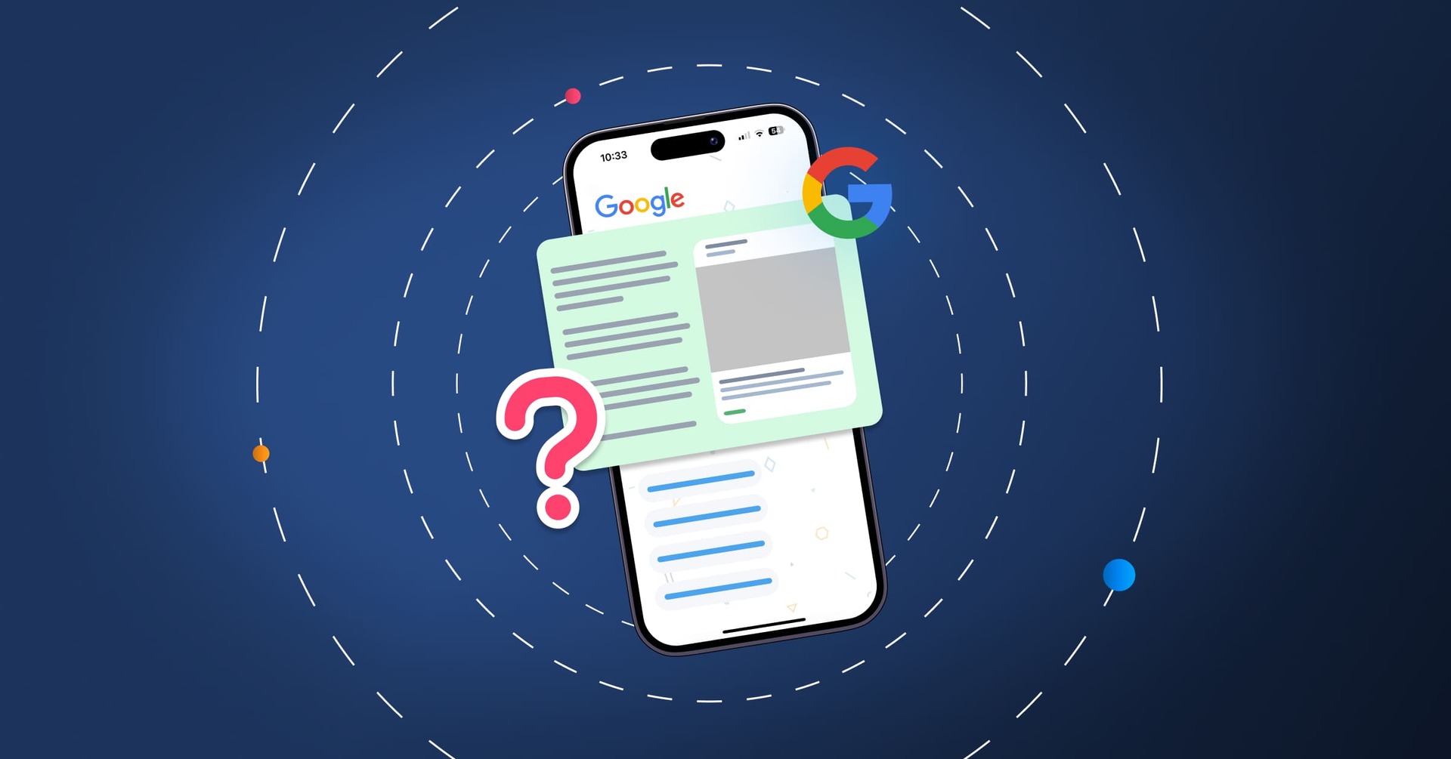
EPL Logo Detector
RESULTS
Training Accuracy: 95%
Validation Accuracy: 98%
Test Accuracy: 98.1%

Slide 9

EPL Logo Detector
FUTURE IMPROVEMENTS
Deploy as a web application with user interface
Add support for historical club logos
Expand to other football leagues

Slide 10
EPL Logo Detector
THANK YOU!
FOR YOUR ATTENTION

